Slide 1

Spring Boot - Actuator
To enable Spring Boot actuator endpoints to your Spring Boot application, we need to add the Spring Boot Starter actuator dependency in our build configuration file.

Slide 2
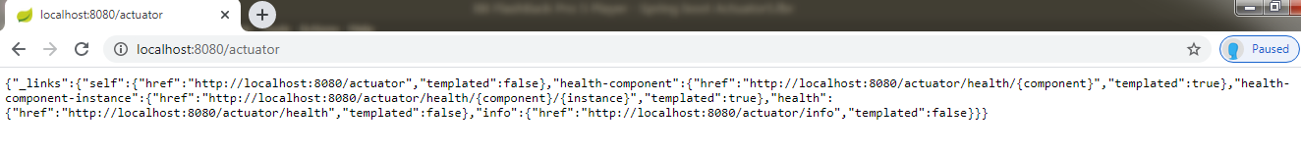
Spring Boot - Actuator
The application will start on port 8080 by default. Once the application has started, you can list all the actuator endpoints exposed over HTTP from the URL http://localhost:8080/actuator

Slide 3
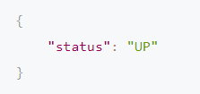
Spring Boot - Actuator
Let’s explore the health endpoint by opening the http://localhost:8080/actuator/health
The status will be UP as long as the application is healthy. It will show DOWN if the application gets unhealthy due to any issue like connectivity with the database or lack of disk space etc.

Slide 4
Spring Boot - Actuator
The info endpoint (http://localhost:8080/actuator/info) displays general information about your application obtained from build files like META-INF/build-info.properties or Git files like git.properties or through any environment property under the key info.

Slide 5
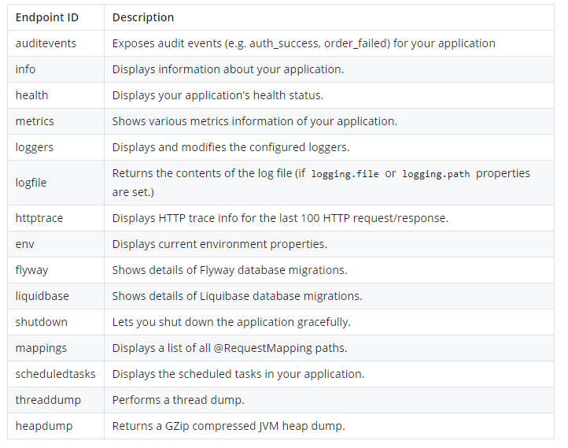
Spring Boot - Actuator
By default, only the health and info endpoints are exposed over HTTP. That’s why the /actuator page lists only the health and info endpoints.

Slide 6
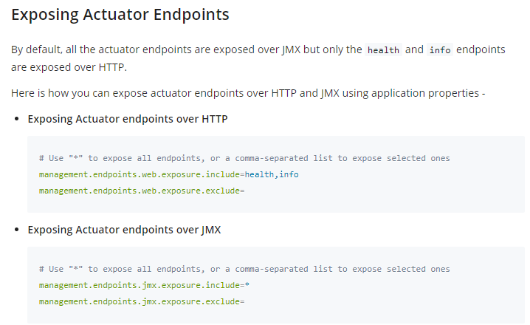
Spring Boot - Actuator

